Slide 1
Network Intrusion Detection PREDICTION
Prepared by :
Munira Alzhrani
Elaf Talal
Faisal Aljowaie

Slide 2
Introduction
About dataset
EDA
AGENDA
Algorithms
Contents Here
Challenges
Get a modern PowerPoint Presentation that is beautifully designed.
Conclusion & Tools

Slide 3
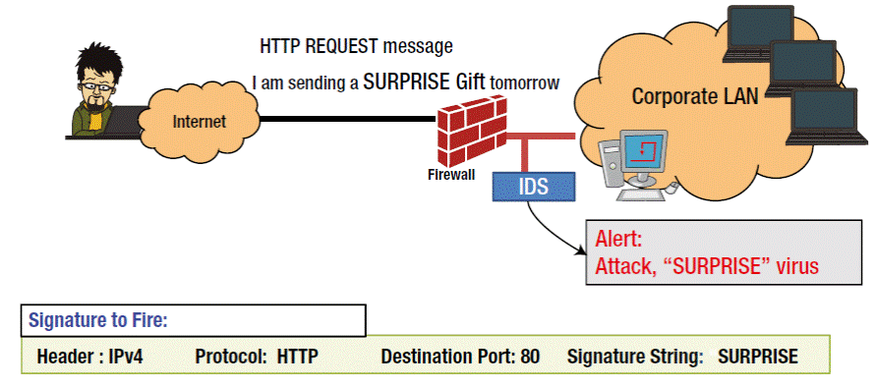
Introduction
Network Intrusion Detection System (NIDS) is a system that monitors network traffic for suspicious activity and issues alerts when such activity is discovered.

Slide 4

Main Goal
Predict the attacks using classification :
Let the government or firms know before it happens.
Keep Your Customers' Trust.
Stay One Step Ahead of Increasing Threat.

Slide 5
Dataset
understanding
Features
Raws
From
43
25192
Kaggle
42

Slide 6
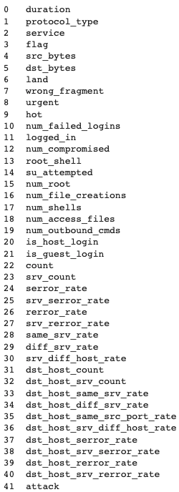
Columns

Slide 7
Methodology
problem
understanding
Data
Cleaning&EDA
Conclusion
Classification
algorithms

Slide 8
DATA CLEANING
Four categorical features, converted them into dummies.
Change class column to attack then change it integer.

Slide 9

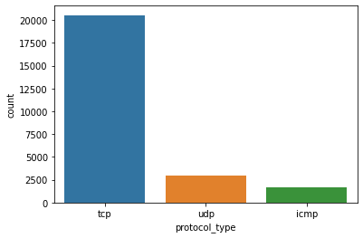
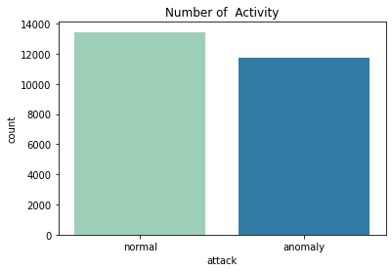
EDA
Protocols usage
Number of Activities

Slide 10
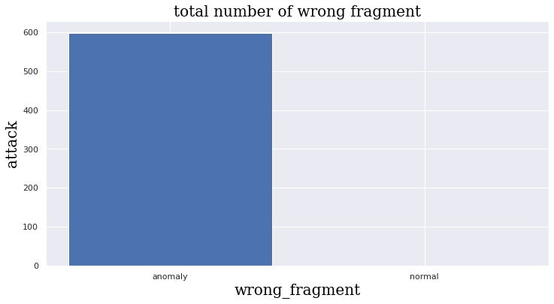
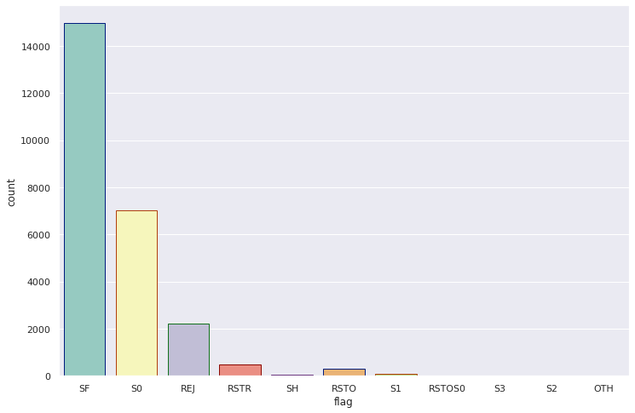
relationship between attack and wrong fragment
Flag distribution

Slide 11
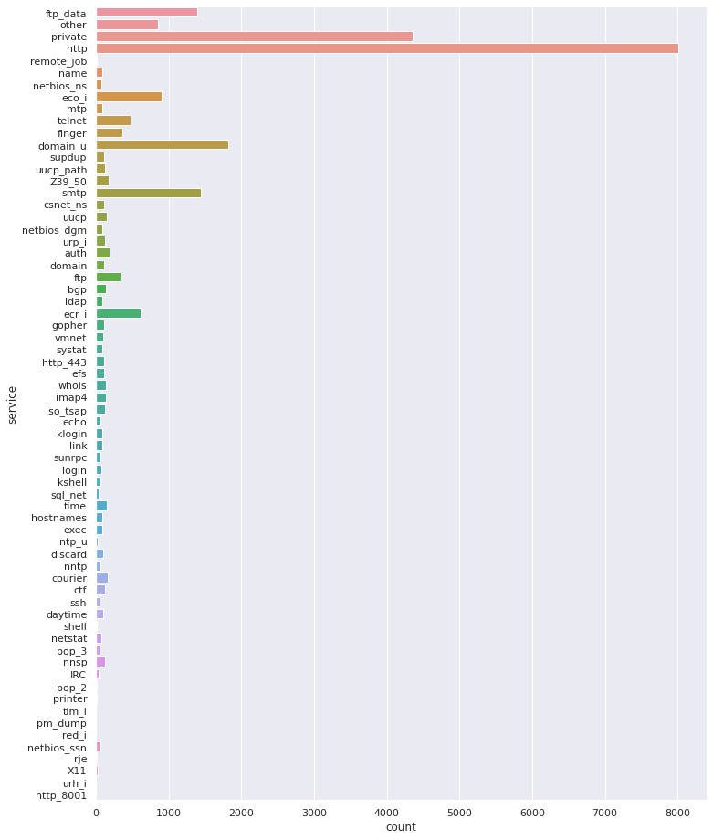
Service distribution

Slide 12
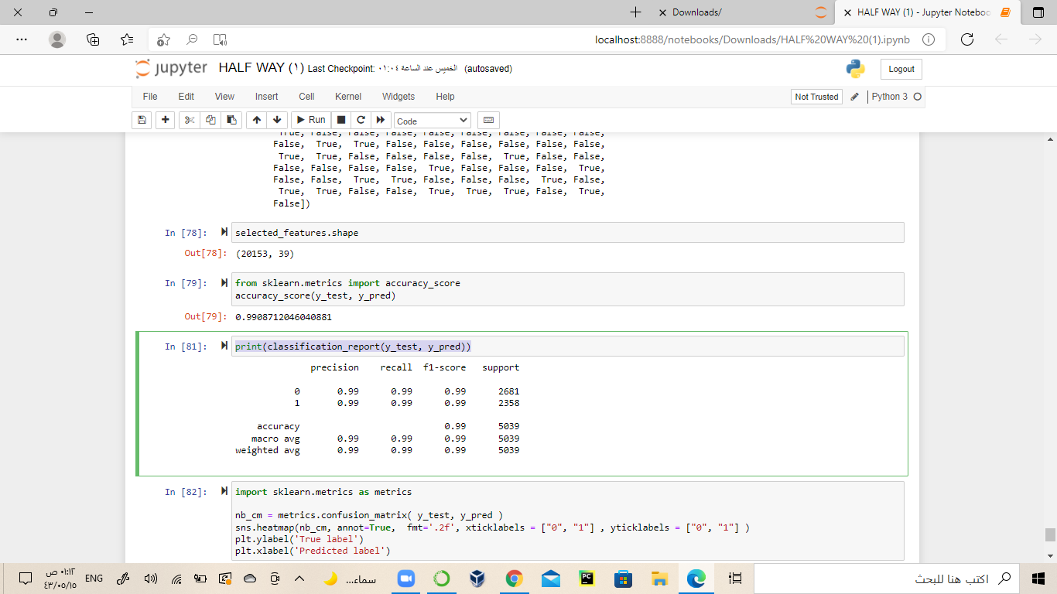
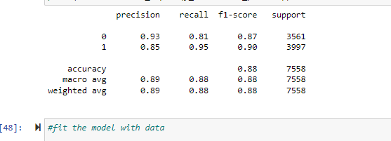
Classification algorithms
Random Forest
LogisticRegression

Slide 13
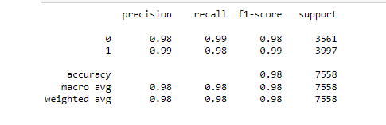
LinearSVC

Slide 14
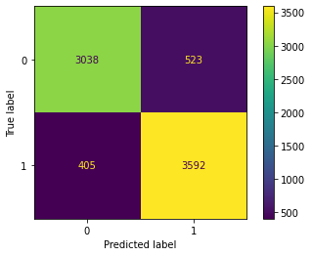
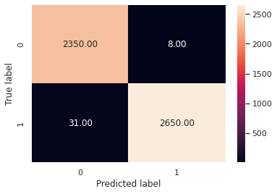
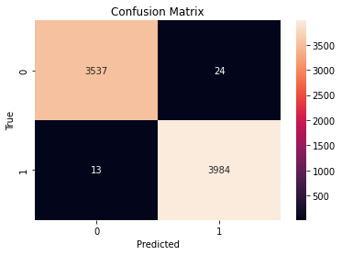
Confusion Matrix
linearSVC
Stacking
logistic

Slide 15
Challenges
Number of columns.
Choosing best algorithm.

Slide 16
Conclusion
Minimize the risk.
Alert IT of any suspicious activity.
Avoid loss of confidence.
IDS must be updated and investigated.

Slide 17
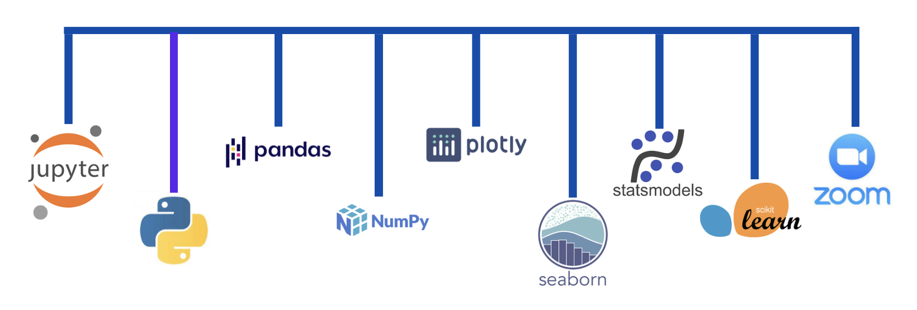
Tools

